Slide 1


BCSE307L – Compiler Design
Module 3 – Semantic Analysis

Slide 2
Contents
Syntax Directed Definition
Evaluation Order
Applications of Syntax Directed Translation
Syntax Directed Translation Schemes
Implementation of L-attributed Syntax Directed Definition.

Slide 3
Syntax-Directed Definitions (SDD)
SDD → CFG with semantic rules
A generalization of context free grammar in which each grammar symbol has an associated set of attributes.
In SDD, every non-terminals can get zero or more attributes.
The attributes can be a number, type, memory location, return type etc.
Types of attributes are:
Synthesized attribute [Values can be evaluated from children]
Ex: A → BC {A.val = fun(B.val, C. Val}
Inherited attribute [Values can be evaluated from the parent or siblings]
Ex: A → BC {B.val = A.val
C.val = B.val}

Slide 4
Syntax Directed Translation Scheme
The Syntax directed translation scheme is a context free grammar
It is used to evaluate the order of semantic rules.
In translation scheme, the semantic rules are embedded within the right side of the production.
The position at which the action to be executed is enclosed between braces, { }.
The position of a semantic action in a production body determines the order in which the action is executed.
Ex1: E → E₁ + {print `+`} T Ex2: E → E₁ + T {print `+`}

Slide 5
Syntax-Directed Definitions and Translation Schemes
When we associate semantic rules with productions, we use two notations:
Syntax-Directed Definitions
Translation Schemes
Syntax-Directed Definitions:
Give high-level specifications for translations
Hide many implementation details such as the order of evaluation of semantic actions.
We associate a production rule with a set of semantic actions, and we do not say when they will be evaluated.
Translation Schemes:
Indicate the order of evaluation of semantic actions associated with a production rule.
In other words, translation schemes give a little bit of information about implementation details.

Slide 6
Syntax-Directed Translation
Conceptually with both the syntax directed definition and translation scheme we
Parse the input token stream
Build the parse tree
Traverse the tree to evaluate the semantic rules at the parse tree nodes.
Input string parse tree dependency graph evaluation order for semantic rules
Conceptual view of syntax directed translation

Slide 7



S-attributed SDT Vs L-attributed SDT
S-attributed SDT | L-attributed SDT
Uses only synthesized attribute Ex. A → BC {A.val=fun(B.val,C.val) | Uses both synthesized attribute and inherited attribute. Inherited attribute can inherit values from either parent or left siblings only Ex: A→BCD {B.V=A.V, C.V=B.V, D.V=C.V} {C.V=D.V}
Semantic actions are placed at the right end of the productions Ex. A → BC {…………} | Semantic actions are placed anywhere on RHS Ex: A→BC {….} | {….} BC | B {….} C
Attributes are evaluated using bottom-up parsing Ex: | By traversing parse tree dept first, left->right

Slide 8
1. S-attributed SDT
Value of synthesized attribute at a node can be computed from the value of attributes at the children of that node in the parse tree.
A syntax directed definition that uses synthesized attribute exclusively is said to be S-attribute definition.
Example: Syntax directed definition of simple desk calculator which evaluates expressions terminated by an endmarker, n
Production | Semantic rules
L → E n | Print (E.val)
E → E₁+T | E.val = E₁.val + T.val
E → T | E.val = T.val
T → T₁*F | T.val = T₁.val * F.val
T → F | T.val = F.val
F → (E) | F.val = E.val
F → digit | F.val = digit.lexval
an integer value returned by lexical
analyzer

Slide 9
Evaluating an SDD at the Nodes of a Parse Tree
The rules of an SDD are applied by first constructing a parse tree and then using the rules to evaluate all of the attributes at each of the nodes of the parse tree.
A parse tree, showing the value(s) of its attribute(s) is called an annotated parse tree.
Each of the nodes for the non-terminals has attribute, val computed in a bottom-up order

Slide 10
Example: Synthesized attributes
String: 3*5+4n;
Production | Semantic rules
L → E_{n} | Print (E.val)
E → E₁+T | E.Val = E₁.val + T.val
E → T | E.Val = T.val
T → T₁*F | T.Val = T₁.val * F.val
T → F | T.Val = F.val
F → (E) | F.Val = E.val
F → digit | F.Val = digit . lexval
L
n
E.val=19
+
T.val=4
E.val=15
The process of computing the attribute values at the node is called annotating or decorating the parse tree
T.val=15
F.val=4
*
digit.lexval=4
T.val=3
F.val=5
F.val=3
digit.lexval=5
parse tree showing the value of the attributes at each node is called Annotated parse tree
digit.lexval=3
Annotated parse tree for 3*5+4n

Slide 11
Exercise
Draw Annotated Parse tree for following using the SDD:
(3+4)*(5+6)n
1*2*3*(4+5)n
(9+8*(7+6)+5)*4n
Production | Semantic rules
L → E_{n} | Print (E.val)
E → E₁+T | E.Val = E₁.val + T.val
E → T | E.Val = T.val
T → T₁*F | T.Val = T₁.val * F.val
T → F | T.Val = F.val
F → (E) | F.Val = E.val
F → digit | F.Val = digit . lexval

Slide 12
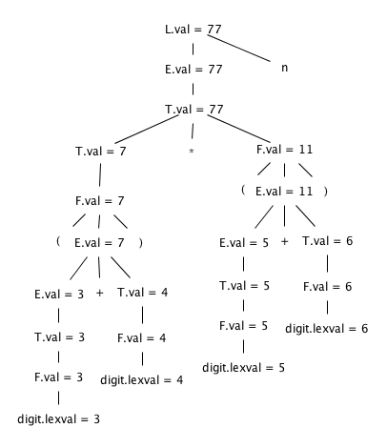
Solution1

Slide 13
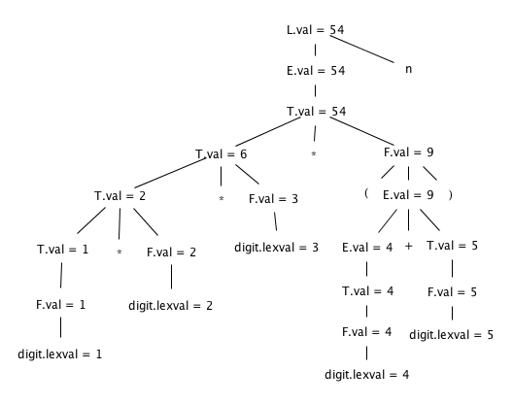
Solution2

Slide 14
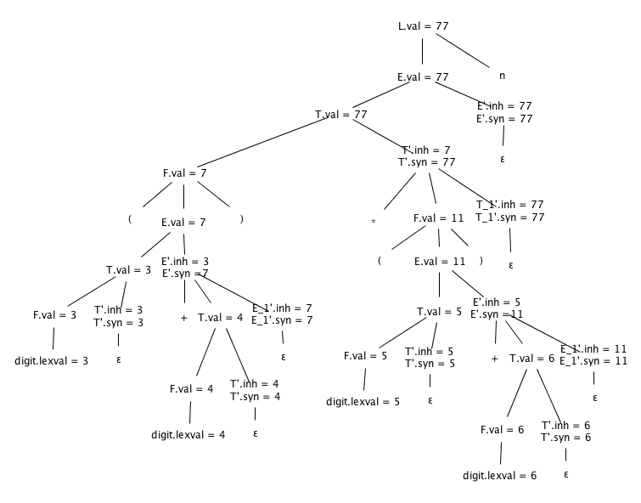
Solution3

Slide 15
Evaluation Orders for SDD's
“Dependency graphs" are a useful tool for determining an evaluation order for the attribute instances in a given parse tree.
Semantic rules set up dependencies between attributes which can be represented by a dependency graph.
While an annotated parse tree shows the values of attributes, a dependency graph helps us determine how those values can be computed.

Slide 16
Dependency Graph
Directed Graph
Shows interdependencies between attributes.
If an attribute b at a node depends on an attribute c, then the semantic rule for b at that node must be evaluated after the semantic rule that defines c.
Construction:
Put each semantic rule into the form b=f(c₁,…,c_{k}) by introducing dummy synthesized attribute b for every semantic rule that consists of a procedure call.
E.g.,
L → E n print(E.val)
Becomes: dummy = print(E.val)
The graph has a node for each attribute and an edge to the node for b from the node for c if attribute b depends on attribute c.

Slide 17

Dependency Graph Construction
Example
Production Semantic Rule
E→E1 + E2 E.val = E1.val + E2.val
E . val
E1. val + E2 . Val
E.val is synthesized from E1.val and E2.val
The dotted lines represent the parse tree that is not part of the dependency graph.

Slide 18
Dependency Graph Construction
for each node n in the parse tree do
for each attribute a of the grammar symbol at n do
construct a node in the dependency graph for a
for each node n in the parse tree do
for each semantic rule b = f(c₁,…,c_{n})
associated with the production used at n do
for i= 1 to n do
construct an edge from the node c_{i} to the node b

Slide 19
Dependency Graph
Dependency graph for the annotated parse tree constructed for the input 5+3*4
L
E.val=17 n
Production | Semantic rules
L → E_{n} | Print (E.val)
E → E₁+T | E.Val = E₁.val + T.val
E → T | E.Val = T.val
T → T₁*F | T.Val = T₁.val * F.val
T → F | T.Val = F.val
F → (E) | F.Val = E.val
F → digit | F.Val = digit . lexval
E.val=5 + T.val=12
T.val=5 T.val=3 * F.val=4
F.val=5 F.val=3 digit.lexval=4
digit.lexval=5 digit.lexval=3

Slide 20
Example – synthesized and inherited attribute
Construct Annotated parse tree for 3 * 5

Slide 21
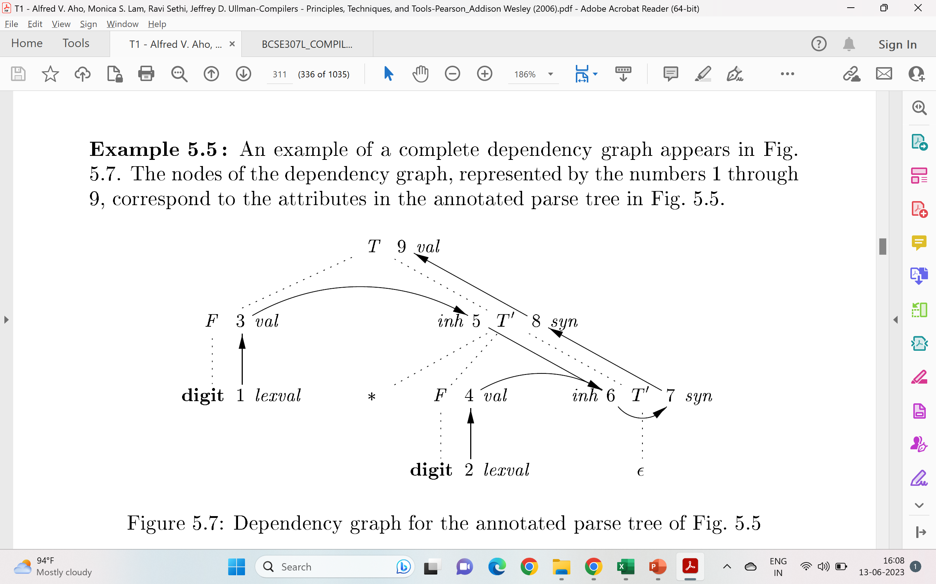
Example for dependency graph

Slide 22
2. L-attributed SDT
Uses both synthesized attribute and inherited attribute
An inherited value at a node in a parse tree is computed from the value of attributes at the parent and/or only left siblings of the node.
Symbol T is associated with a synthesized attribute, type.
Symbol L is associated with an inherited attribute, in.
Production | Semantic rules
D → T L | L.in = T.type
T → int | T.type = integer
T → real | T.type = real
L → L₁ , id | L₁.in=L.in, addtype(id.entry,L.in)
L → id | addtype(id.entry,L.in)
a lexical value that points to a symbol-table object
the type being assigned to every identifier
Syntax directed definition with inherited attribute L.in

Slide 23
Example: L-attributed SDT
Example: Pass real data types to all identifier id1,id2,id3
D
Production | Semantic rules
D → T L | L.in = T.type
T → int | T.type = integer
T → real | T.type = real
L → L₁ , id | L₁.in = L.in, addtype(id.entry,L.in)
L → id | addtype(id.entry,L.in)
L
T
L.in=real
T.type=real
real
,
id
L₁
id3
L.in=real
,
id2
L.in=real
id
L₁
id
id1
L → L₁ , id
L → id
D→TL

Slide 24
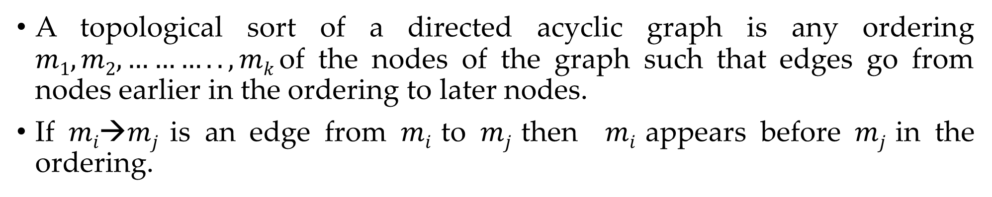
Evaluation order
A topological sort of a directed acyclic graph is any ordering $m1, m2,……….., mk$of the nodes of the graph such that edges go from nodes earlier in the ordering to later nodes.
If $mi→mj$is an edge from $mi$ to $mj$ then $mi$ appears before $mj$ in the ordering.
D
1
T.type=real
L.in=real
2
real
3
,
L.in=real
id3
4
,
id2
5
L.in=real
6
7
id1

Slide 25
Dependency graph
Dependency graph for a declaration real id₁,id₂,id₃
Numbers 1 through 10 represent the nodes of the dependency graph.
Nodes 1, 2, and 3 represent the attribute entry associated with each of the leaves labeled id.
Nodes 6, 8, and 10 are the dummy attributes that represent the application of the function addType to a type and one of these entry values
Node 4 represents the attribute T:type, and is actually where attribute evaluation begins.
This type is then passed to nodes 5, 7, and 9 representing L:inh associated with each of the occurrences of the nonterminal L

Slide 26
Exercise
For the SDD given, give annotated parse trees for the following expressions:
int a, b, c

Slide 27
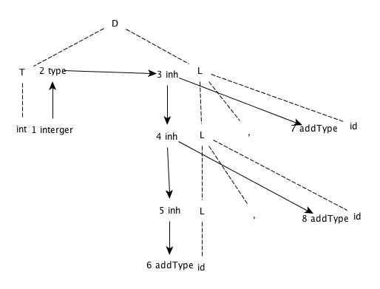
Solution

Slide 28
Applications of SDT
Creating Syntax Tree
Conversion from Infix to Postfix
Conversion from Infix to Prefix
Executing Arithmetic Expression
Conversion from Binary to Decimal
Counting No. of Reductions
Generating Intermediate Code
Type Checking
Storing Type information into Symbol Table.

Slide 29
Construction of syntax tree
Following functions are used to create the nodes of the syntax tree.
Mknode (op,left,right): creates an operator node with label op and two fields containing pointers to left and right.
Mkleaf (id, entry): creates an identifier node with label id and a field containing entry, a pointer to the symbol table entry for the identifier.
Mkleaf (num, val): creates a number node with label num and a field containing val, the value of the number.
Note:
X → YZ {action/rules} the rules associated with X will evaluated after executing the actions of Y & Z

Slide 30
Construction of syntax tree for expressions
Example: construct syntax tree for a-4+c
P1: mkleaf(id, entry for a);
P2: mkleaf(num, 4);
P3: mknode(‘-‘,p1,p2);
P4: mkleaf(id, entry for c);
P5: mknode(‘+’,p3,p4);
P5
+
P3
-
P4
id
Entry for c
P1
id
P2
Num | 4
Entry for a

Slide 31
SDT to build syntax tree
Step1: Build parse Tree
Prodn. | Semantic rules/action
E → E1 + T | {E.nptr = mknode(‘+’, E1.nptr, T.nptr);}
E → T | {E. nptr = T.nptr;}
T → T1 * F | {T.nptr = mknode(‘*’, T1.nptr, F.nptr);}
T → F | {T. nptr = F.nptr;}
F → id | {F.nptr = mkleaf(id, id.entry);}
Example: Input string a + b * c

Slide 32
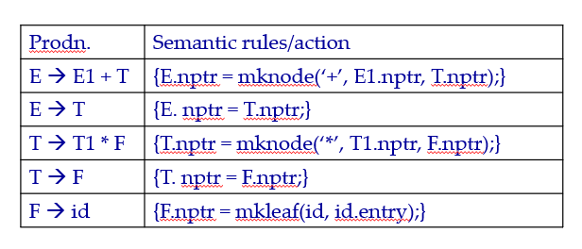
Cont…
Step2: Build Annotated parse Tree

Slide 33
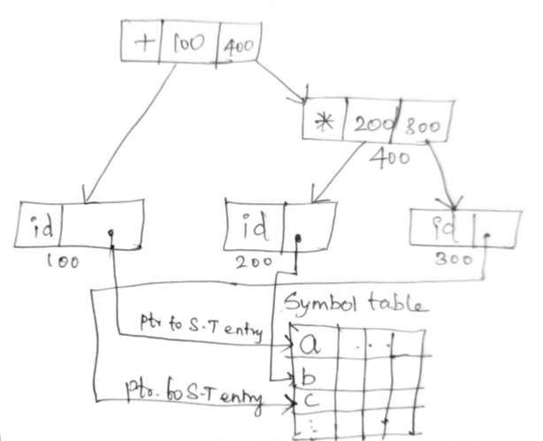
Cont…
Step2: Build Annotated parse Tree
Step3: Syntax Tree

Slide 34
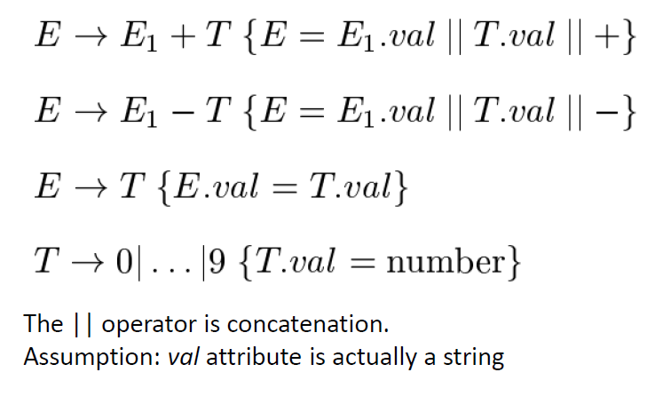
Syntax directed definition to translates arithmetic expressions
Infix to postfix notation (Simple)

Slide 35

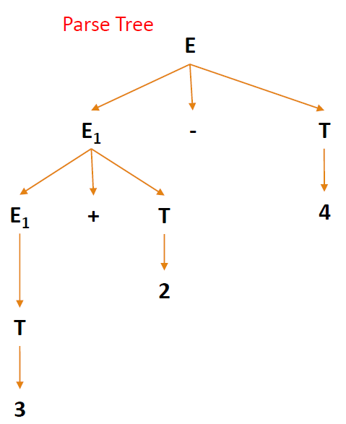
Syntax directed definition to translates arithmetic expressions
Infix to postfix notation (Simple)

Slide 36
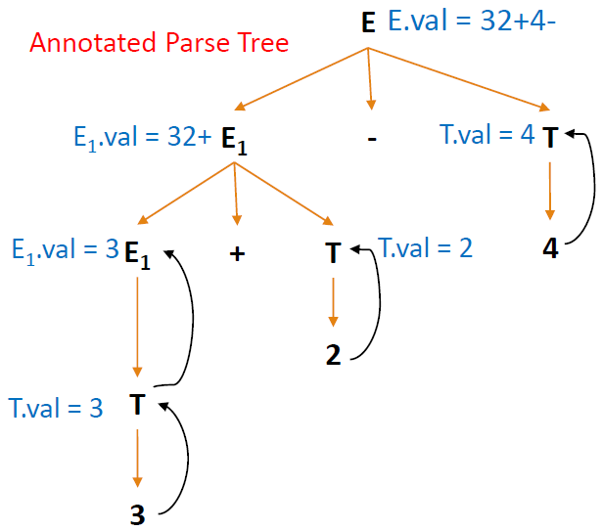
Syntax directed definition to translates arithmetic expressions
Infix to postfix notation (Simple)

Slide 37
Syntax directed definition to translates arithmetic expressions
Infix to prefix notation
Production | Semantic rules
L→E | Print(E.val)
E→E+T | E.val=’+’ E.val T.val
E→E-T | E.val=’-‘ E.val T.val
E→T | E.val= T.val
T→T*F | T.val=’*’ T.val F.val
T→T/F | T.val=’/’ T.val F.val
T→F | T.val= F.val
F→F^P | F.val=’^’ F.val P.val
F→P | F.val= P.val
P→(E) | P.val= E.val
P→digit | P.val=digit.lexval

Slide 38
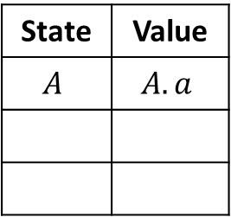
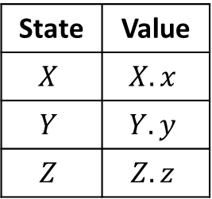
Bottom up evaluation of S-attributed definitions
S-attributed definition is one such class of syntax directed definition with synthesized attributes only.
Synthesized attributes can be evaluated using bottom up parser only.
Synthesized attributes on the parser stack
Consider the production A→XYZ and associated semantic action is A.a=f(X.x, Y.y, Z.z)
State | Value
$$X$$ | $$X.x$$
$$Y$$ | $$Y.y$$
$$Z$$ | $$Z.z$$
State | Value
$$A$$ | $$A.a$$
top-2
top
top-1
top
Before reduction
After reduction

Slide 39
Bottom up evaluation of S-attributed definitions
Production | Semantic rules
L → E_{n} | Print (val[top])
E → E₁+T | val[top]=val[top-2] + val[top]
E → T
T → T₁*F | val[top]=val[top-2] * val[top]
T → F
F → (E) | val[top]=val[top-1]
F → digit
Input | State | Val | Production Used
3*5n | - | -
*5n | 3 | 3
*5n | F | 3 | F→digit
*5n | T | 3 | T→F
5n | T* | 3
n | T*5 | 3,5
n | T*F | 3,5 | F→digit
n | T | 15 | T→T₁*F
n | E | 15 | E→T
Implementation of a desk calculator with bottom up parser
 | En | 15
 | L | 15 | L → E_{n}
Move made by translator

Slide 40
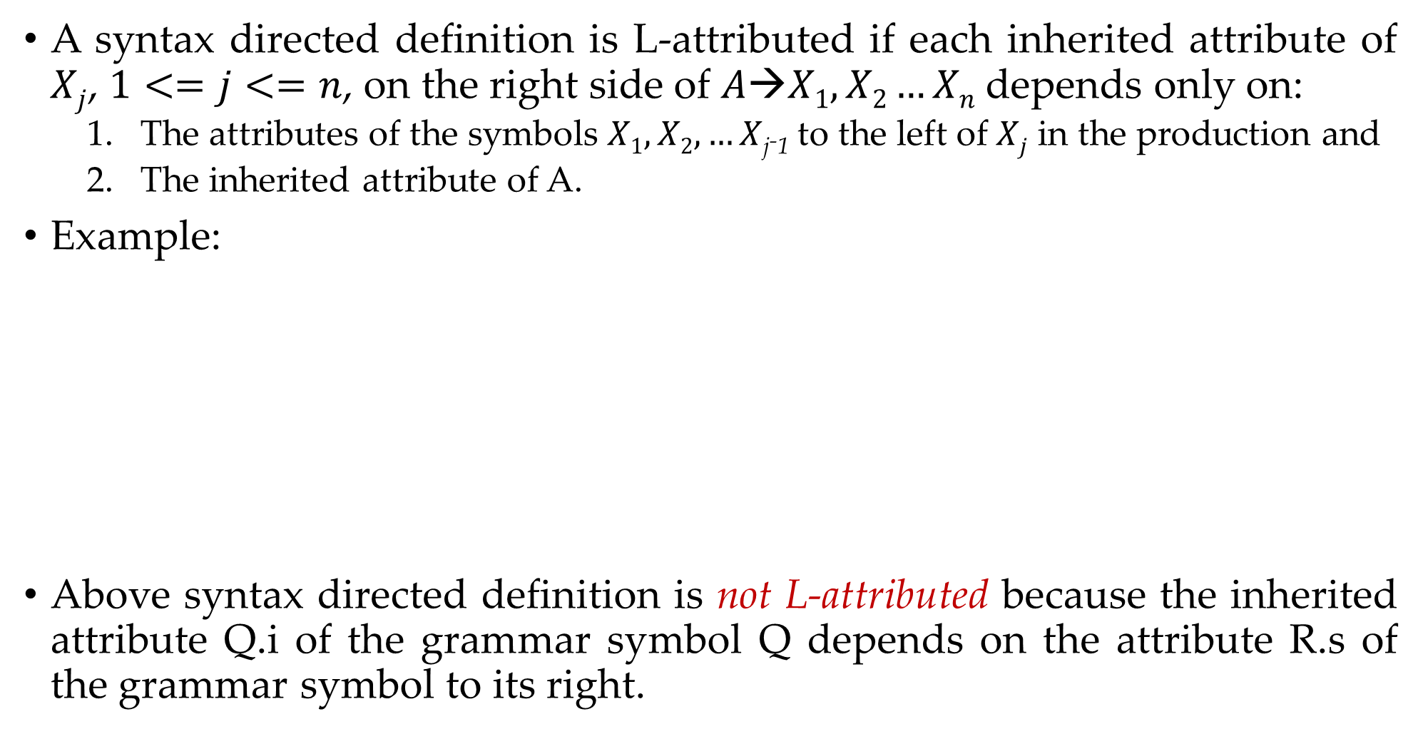
L-Attributed definitions
A syntax directed definition is L-attributed if each inherited attribute of $Xj$, $1<=j<=n$, on the right side of $A→X1,X2…Xn$depends only on:
The attributes of the symbols $X1,X2,…X$_{j-1} to the left of $Xj$ in the production and
The inherited attribute of A.
Example:
Above syntax directed definition is not L-attributed because the inherited attribute Q.i of the grammar symbol Q depends on the attribute R.s of the grammar symbol to its right.
Production | Semantic Rules
A→ LM | L.i:=l(A.i) M.i=m(L.s) A.s=f(M.s)
A→ QR | R.i=r(A.i) Q.i=q(R.s) A.s=f(Q.s)
A→XYZ
Not L- Attributed
L- Attributed

Slide 41
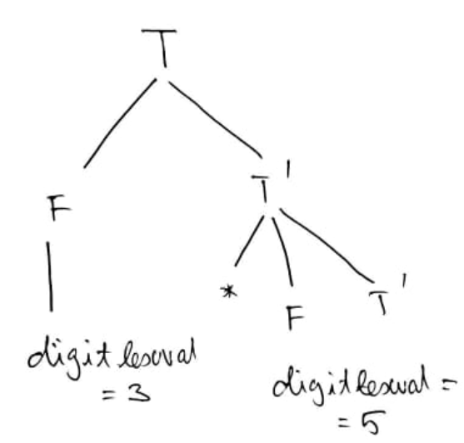
L-Attributed definitions
Annotate the given grammar to perform 3*5
Production
T → FT’
T’ → *FT1’
T → ε
F → digit
Prodn. | Semantic rules/action
T → FT’
T’ → *FT1’
T → ε
F → digit
T’.i = F.val
T.Val = T’.s
T’.i = T’.i * F.val
T’.s = T1’.s
T’.s = T’.i
F.val = digit.lexval

Slide 42
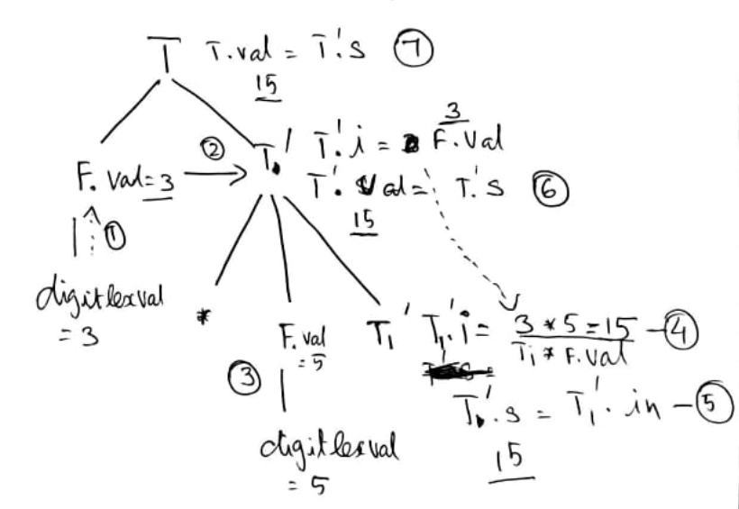
L-Attributed definitions
Annotate the given grammar to perform 3*5
Production
T → FT’
T’ → *FT’
T → ε
F → digit
Prodn. | Semantic rules/action
T → FT’ | T’.i = F.val T.Val = T’.s
T’ → *FT’ | T’.i = T’.i * F.val T’.s = T1’.s
T → ε | T’.s = T’.i
F → digit | F.val = digit.lexval

Slide 43
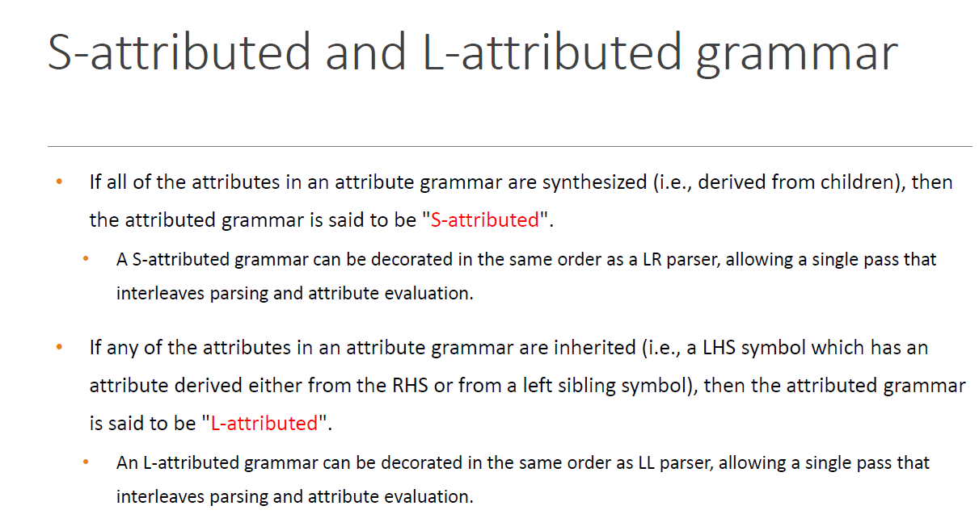

Slide 44
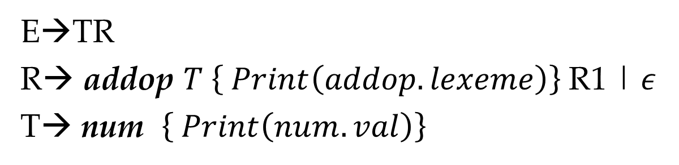
Example: Translation scheme (Infix to postfix notation)
String: 9-5+2
E→TR
R→ addop $T \left\{ Print\left(addop.lexeme\right)\right\}$R1 | 𝜖
T→ num $\left\{ Print\left(num.val\right)\right\}$
E
T
R
-
T
R
9
{Print(9)}
{Print(-)}
5
{Print(5)}
+
R
T
{Print(+)}
2
{Print(2)}
𝜖
Now, Perform Depth first traversal
Postfix=95-2+

